Slide 1
Buildings Sector Scenarios (BSS) Reference Slides, Public Version 1
LBNL: Margaret Pigman, Jared Langevin, Handi Chandra Putra, Xinwei Zhuang, Andy Satchwell NREL: Andrew Parker, Chioke Harris, Eric Ringold, Eric Wilson

Slide 2
Background

Slide 3
Detailed buildings sector energy data to unlock a critical demand-side resource
Problem:
A wide range of energy system stakeholders (e.g., utilities, industry, program managers) require technology-specific projections of buildings sector evolution at a variety of scales and scopes to support planning.
Lack of these estimates undermines confidence in demand-side energy system resources in buildings and puts the onus on supply-side innovation.
Buildings impact lives and intersect with all other energy sectors; comprehensive building modeling is critical for assessing energy system futures.
Objectives:
Define and publish a benchmark set of U.S. buildings sector energy and cost scenario projections through 2050.
Link modeling tools to generate data across multiple spatiotemporal resolutions to support many types of assessments of buildings sector energy futures.

Slide 4
Methods

Slide 5
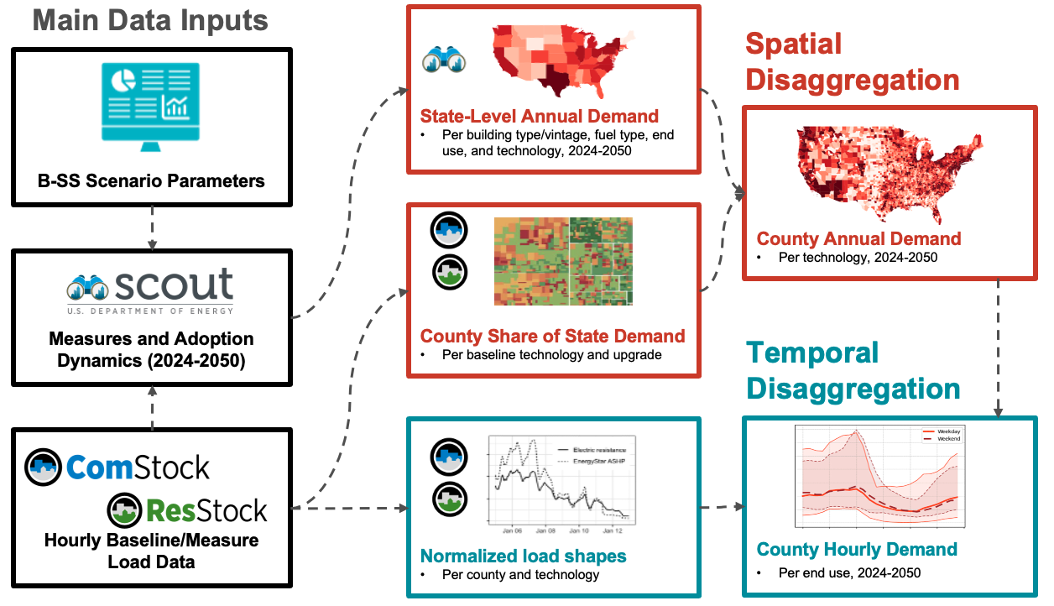
The analysis workflow links together scenario projections with granular load profiles

Slide 6
Modeling outputs range from national- to county-level and annual to hourly resolution
Modeling Feature | Represented | Not Represented
Geographic coverage | - Contiguous US (48 states + DC) | - AK, HI, territories
Weather | - 2018 AMY - County-level weather files | - Changes in load shape based on weather year
Climate change | - HDD/CDD projections from the National Energy Modeling System (NEMS)/AEO at census-division level | - Differences within a census division
Building types | - Building types covered in NEMS/AEO | - Standalone data centers
Building stock growth, population change and migration | - NEMS/AEO projections at census-division level | - Differences within a census division
End uses | - HVAC, lighting, water heating, refrigeration, appliances, plug loads, miscellaneous | - EVs - Storage and distributed solar
Energy carriers | - Electricity (hourly, county) - Natural gas, fuel oil, biofuels (annual, state); aggregated in reporting as “Non-electric”
Technology adoption rates | - Affected by installed cost (inclusive of federal and state/utility incentives), operating cost, market availability, and state/local drivers like codes/standards (see Appendix) | - Differences within a state

Slide 7






~200 measures and packages span the full range of demand-side solutions in buildings
All measure and package assumptions and sources are summarized in an input XLSX that is available on request. Measures are of five types:
Efficient Equipment
Reductions in the energy a device consumes to meet given service level.
Efficient Envelopes
Reductions in heating/cooling service demand via, e.g., better windows, insulation, etc.
Technology Switching
Conversion of resistance-based heating/WH to electric heat pumps.
Full/Dual Fuel Switching Conversion of fossil-based equipment to electric alternatives that serve full load or switch to fossil backup in colder conditions.
Demand Flexibility Controls enable load shedding/shifting based on net system load conditions.

Slide 8
Scenarios cover a range of plausible buildings futures and explore load growth sensitivities

Slide 9
The scope and timing of assumed technology, market, and policy drivers varies by scenario

Slide 10
Baseline calibration: Benchmarking our starting point against monthly historical data
Approach:
Incorporate annual baseline updates from Scout:
AEO 2025 projections
Updated approach to disaggregation from Census Division to State
Map gap model shape (see Appendix) to annual baselines:
Identify and partition portion of Scout commercial annual energy that is uncovered in ComStock based on CBECS 2018, apply gap to this partitioned energy
Also assign gap to commercial “non-building” energy in AEO forecast
Calibrate resulting annual load forecasts for 2020-2024 against EIA-861M monthly total electricity by state and sector
Monthly multiplier by state and sector that is applied to all end uses
AEO is disaggregated to months using 2018 weather

Slide 11
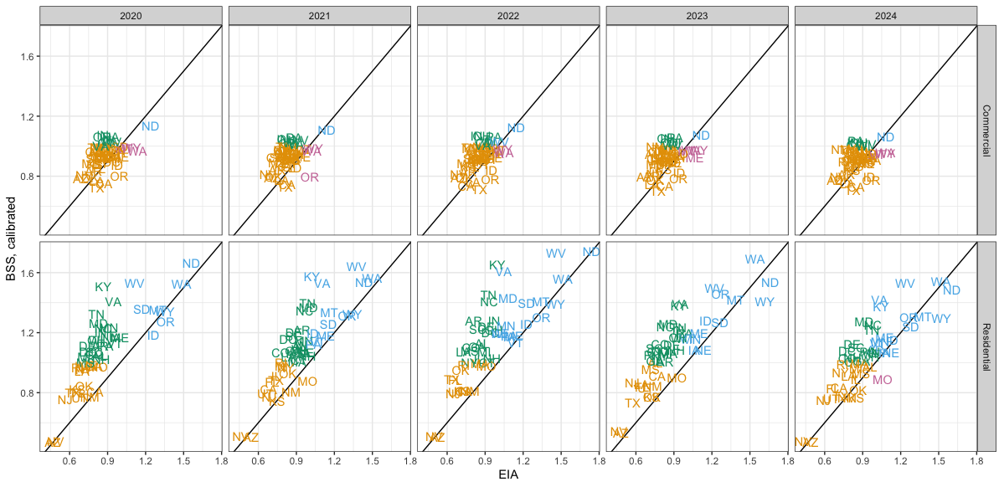
Baseline calibration: Ratio of maximum winter and summer months before calibration
Season with maximum monthly consumption
Disagree:
BSS winter
EIA summer
Both
winter
Both
summer
Disagree:
BSS summer
EIA winter
Uncalibrated, BSS and EIA 861M often disagree about the season with the max monthly consumption (residential: 30-47%; commercial: 18-22%)
BSS predicts far more winter-peaking states
Note: BSS is disaggregated to month using 2018 weather.

Slide 12
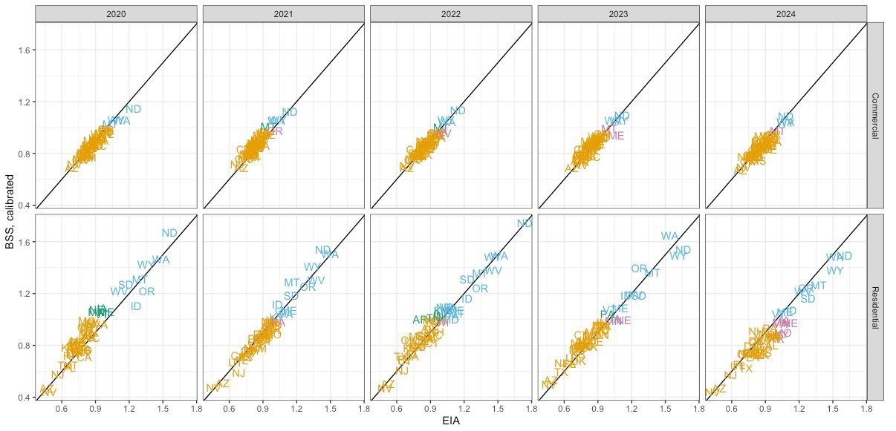
Baseline calibration: Ratio of maximum winter and summer months after calibration
Season with maximum monthly consumption
Disagree:
BSS winter
EIA summer
Both
winter
Both
summer
Disagree:
BSS summer
EIA winter
After calibration, BSS and EIA 861M disagree much less frequently about the season with max monthly consumption (residential: 2-14%; commercial:2-6%)
Note: BSS is disaggregated to month using 2018 weather.

Slide 13
Results

Slide 14
Results Top-line annual energy trends

Slide 15
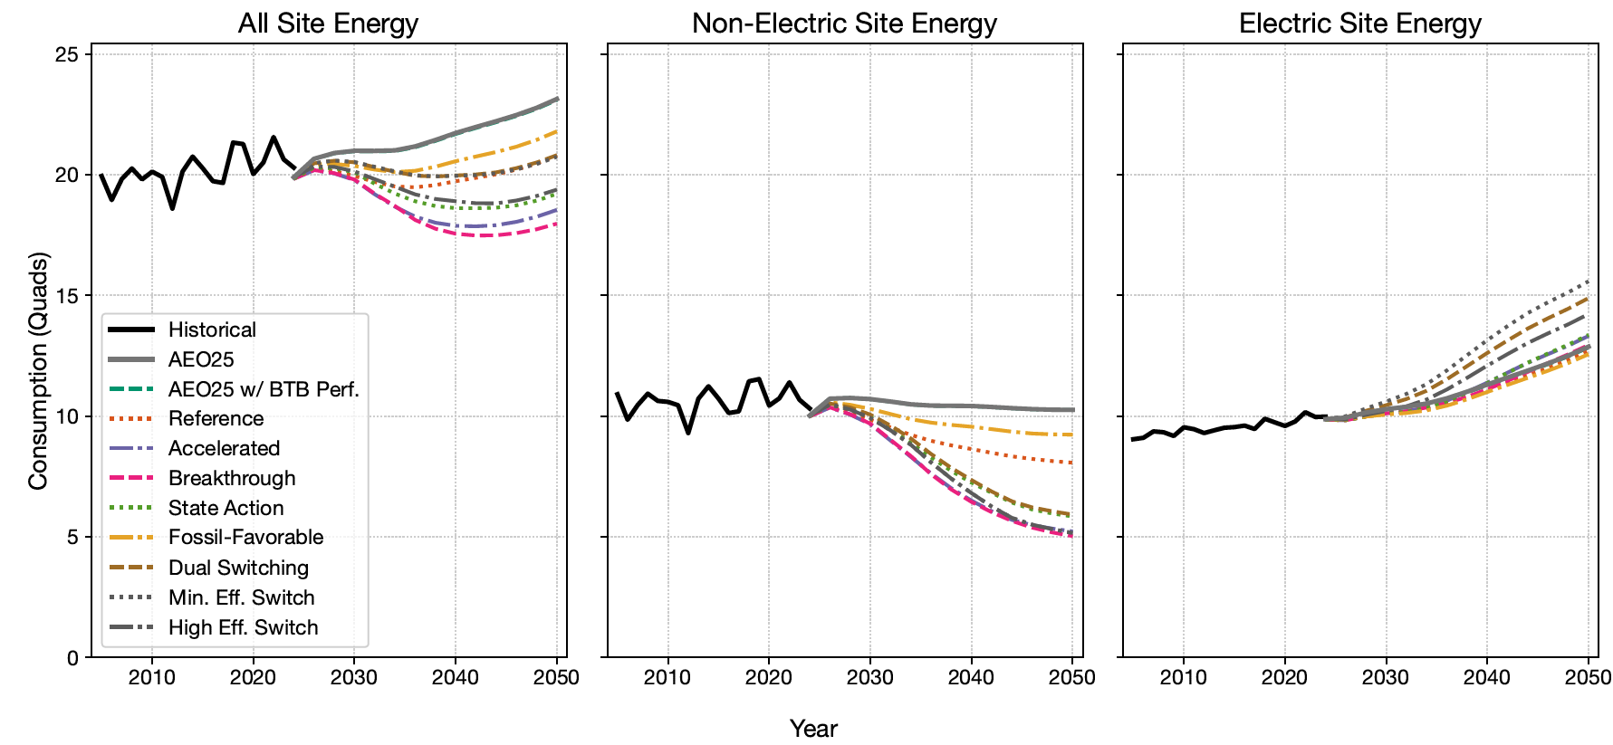
Annual US: Potential for steep non-electric reductions w/ modest electric demand gains
~21% higher than AEO25 (Min. Eff. Switch)
~22% lower than AEO25 (Breakthrough)
~1% lower than AEO25 (Fossil-Favorable)
~51% lower than AEO25 (Breakthrough)

Slide 16
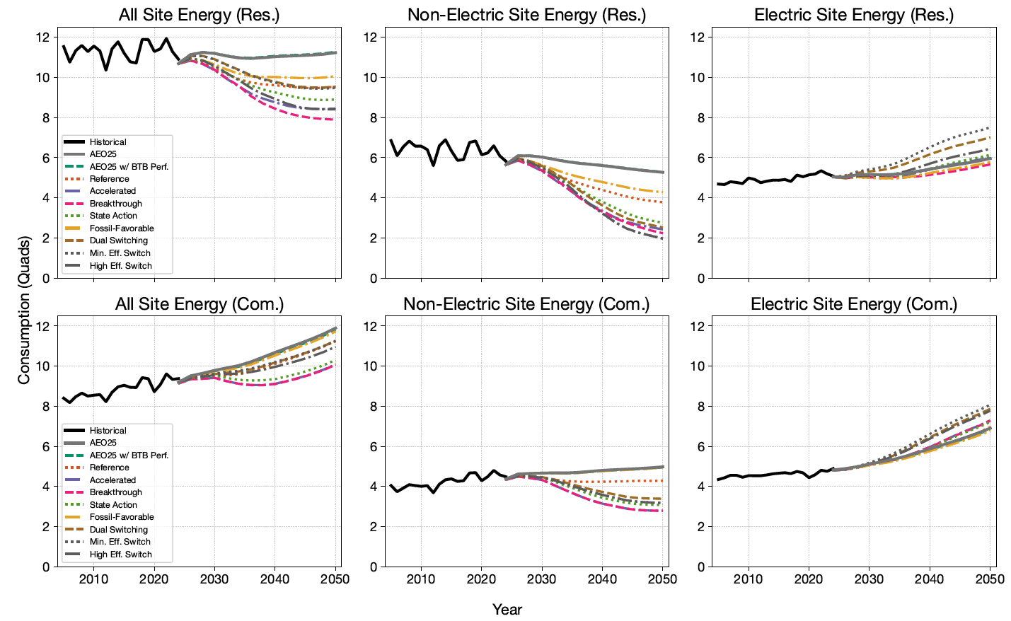
Annual US: Larger residential impacts; codes/BPS drive commercial impacts
~26% higher than AEO25 (Min. Efficiency Switch)
~30% lower than AEO25 (Breakthrough)
~58% lower than AEO25 (Min. Efficiency Switch)
~5% lower than AEO25 (Breakthrough)
~17% higher than AEO25 (Min. Efficiency Switch)
~15% lower than AEO25 (Breakthrough)
~44% lower than AEO25 (Breakthrough)
~5% lower than AEO25 (Fossil-Favorable)

Slide 17
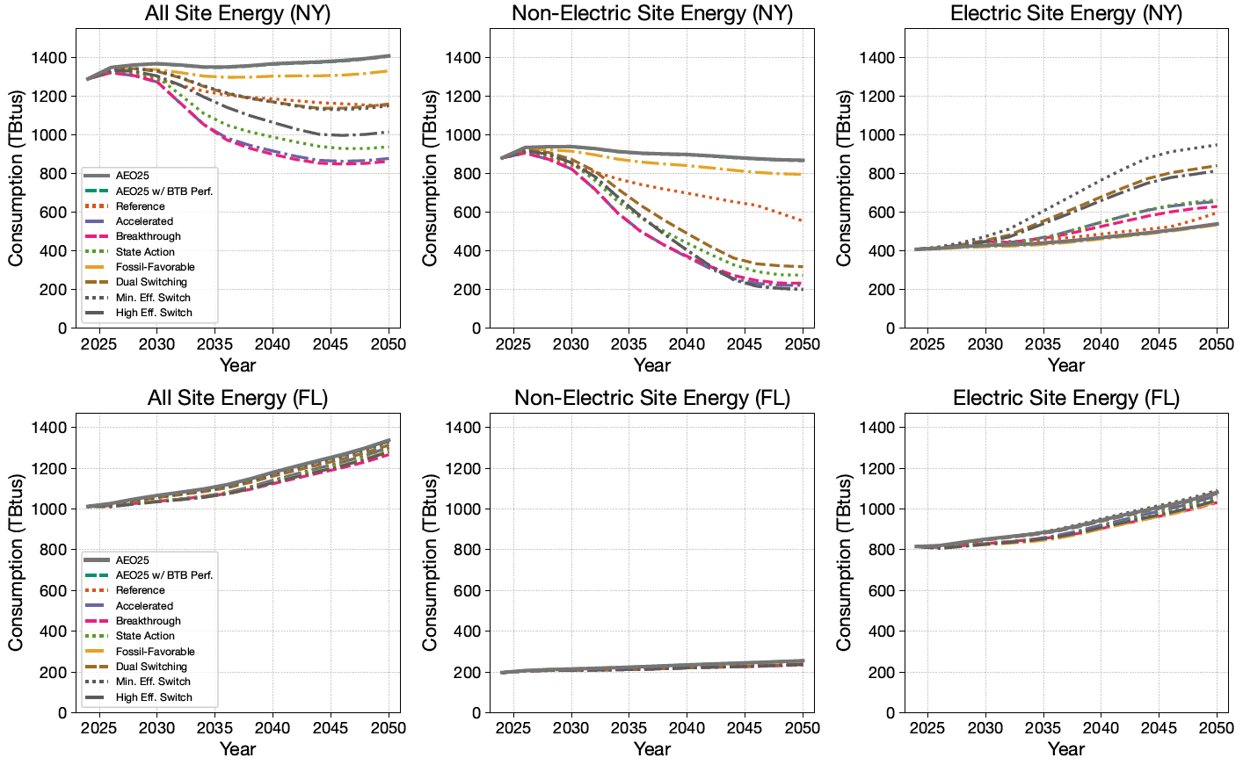
Annual by state: Results vary widely depending on thermal loads and policy

Slide 18
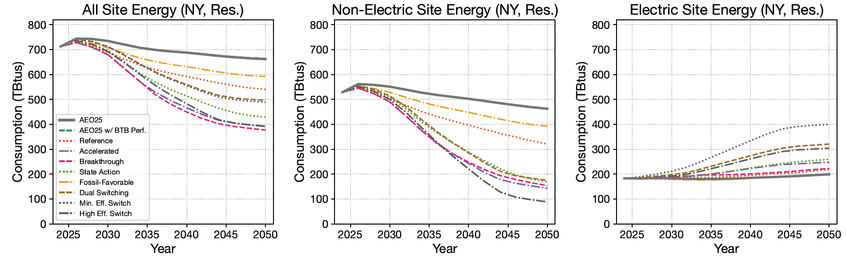
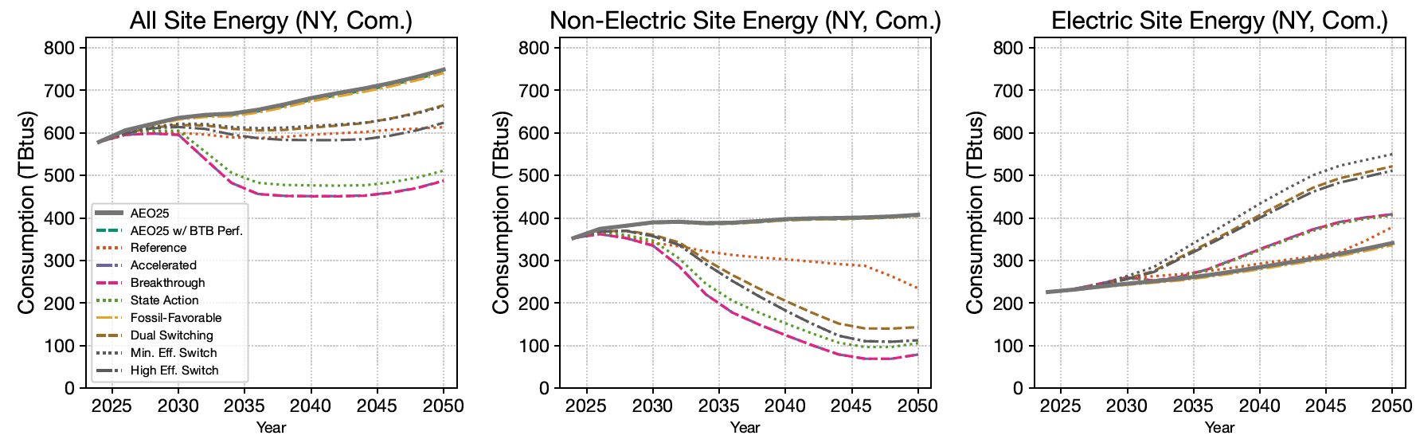
Annual by state: States with pro-electric tech. policy see up to ~2X demand increase by 2050

Slide 19
Results Annual energy trend breakouts

Slide 20
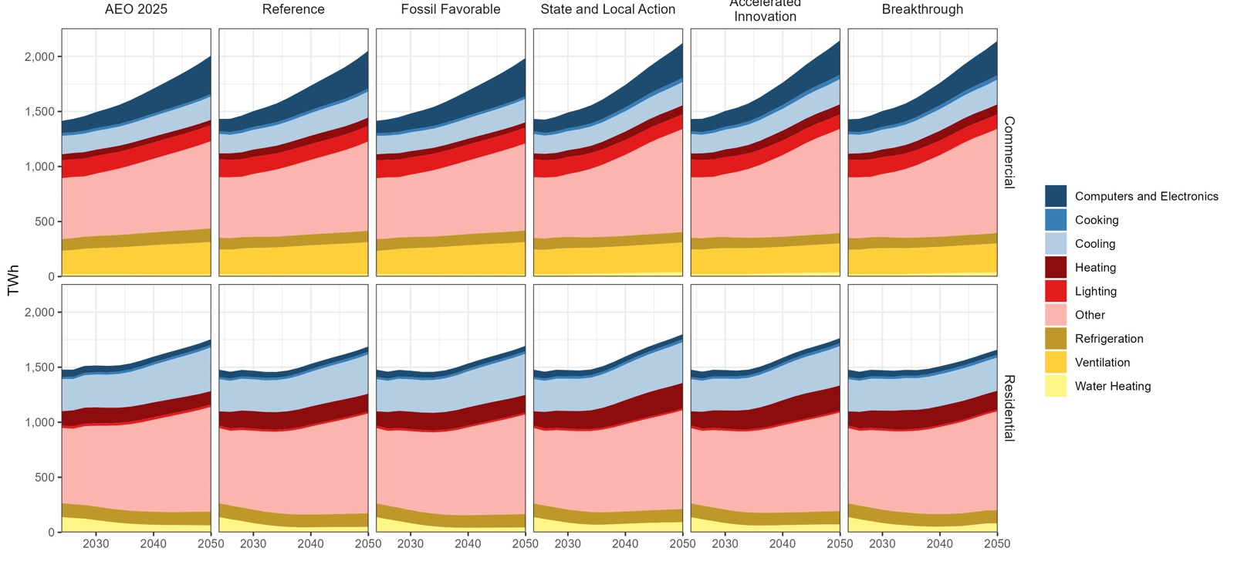
There is more variation in commercial electricity consumption than residential for the core scenarios
Buildings electricity consumption
Note:
”Other” includes vacation homes, household appliances, pool heaters and pumps, misc. electric loads, ‘non-building’ loads, model error, etc.

Slide 21
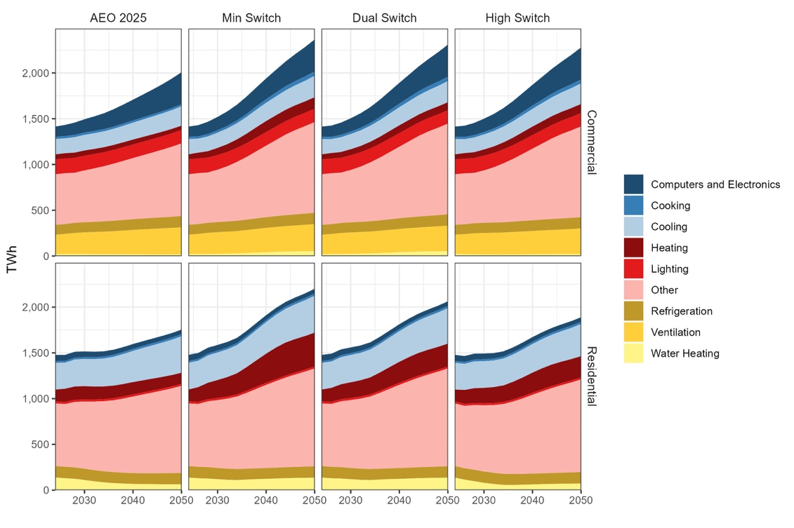
Residential consumption is notably higher under a minimum efficiency fuel switching sensitivity, with increases driven by heating
Buildings electricity consumption
Note:
”Other” includes vacation homes, household appliances, pool heaters and pumps, misc. electric loads, ‘non-building’ loads, model error, etc.

Slide 22
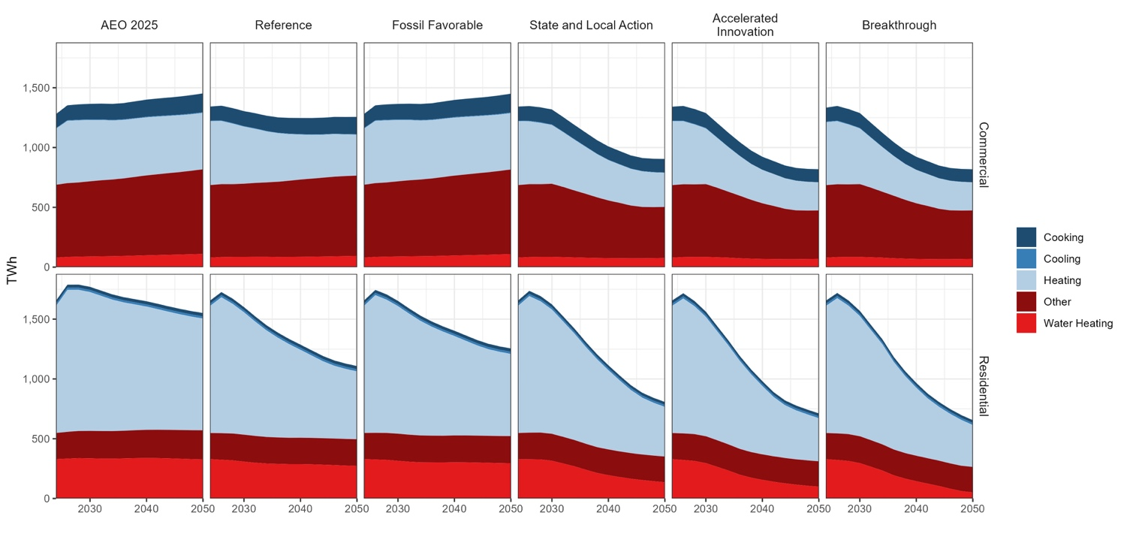
Fuel switching of heating drives overall changes in fossil consumption; ‘other’ fossil has strong influence in commercial
Buildings fossil consumption

Slide 23
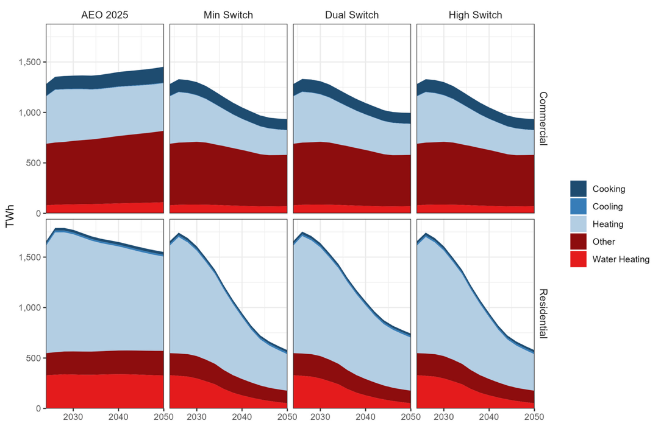
Fuel switching of heating drives overall changes in fossil consumption; ‘other’ fossil has strong influence in commercial
Buildings fossil consumption

Slide 24
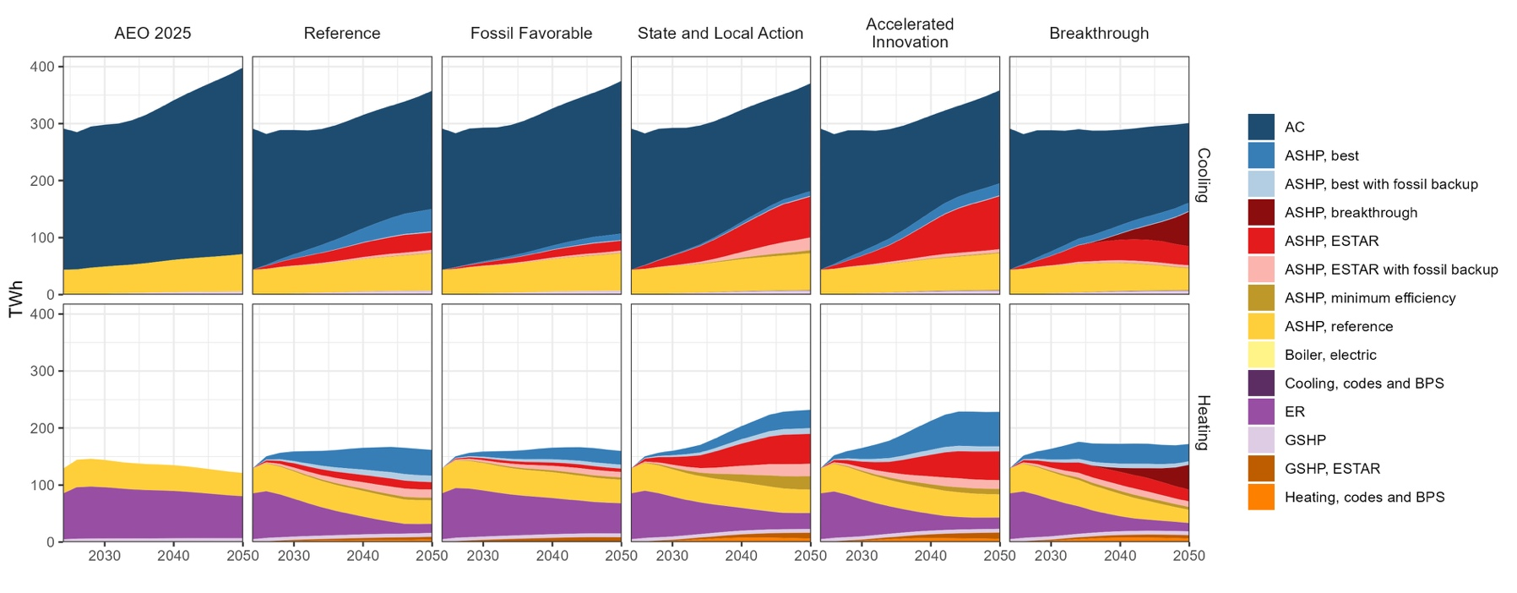
State and local actions drive substantial heat pump adoption
Residential cooling and heating electricity
Notes:
Cooling efficiency from ENERGY STAR heat pumps is offset by greater added cooling due to heat pump adoption.
Technology groupings include installations with and without envelope upgrades.

Slide 25
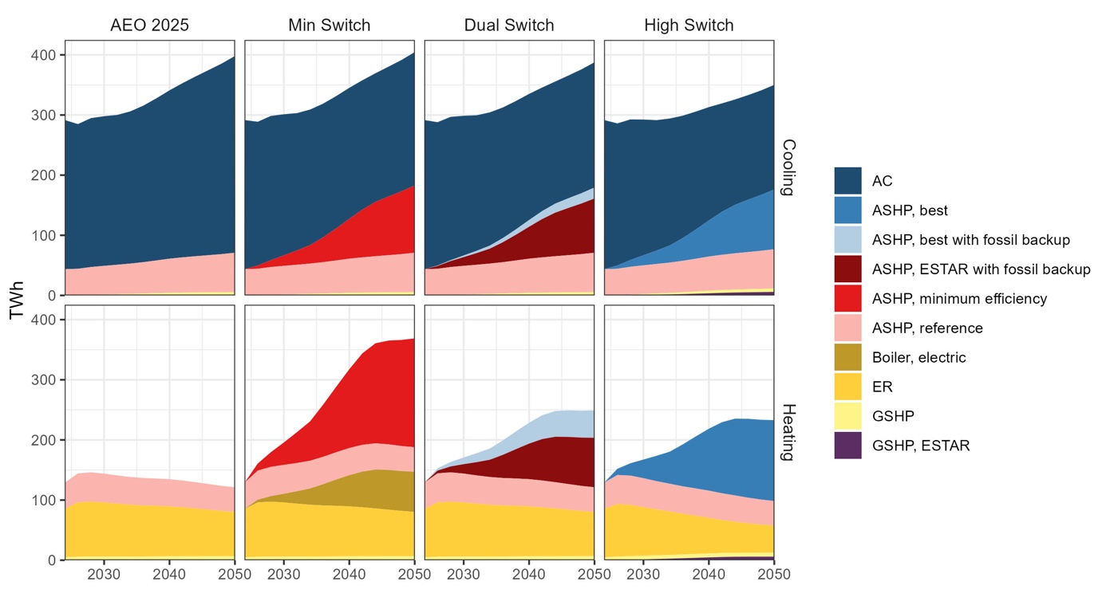
High fuel switching to min. eff. electric heating raises annual demand; dual fuel or higher-efficiency electric heating slows this growth
Residential cooling and heating electricity

Slide 26
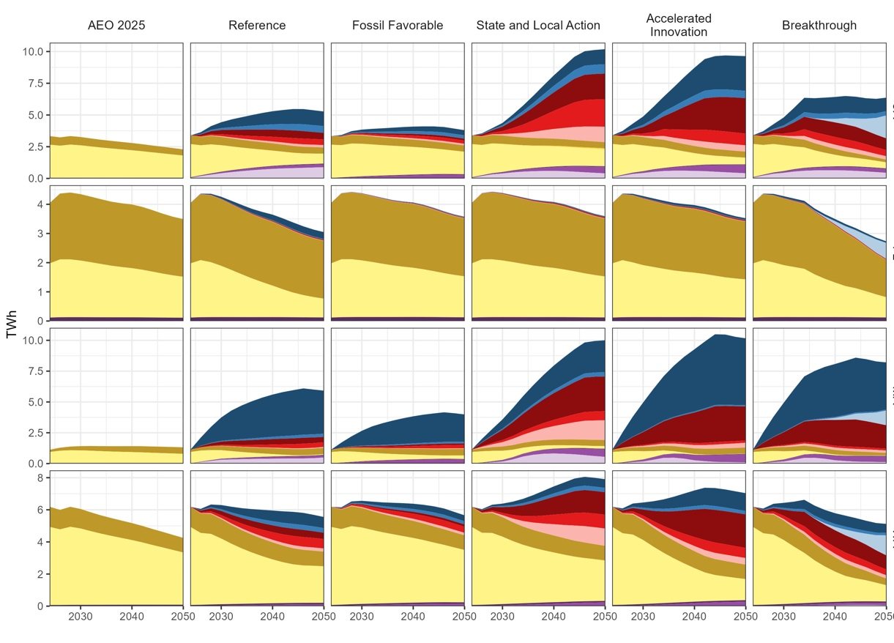
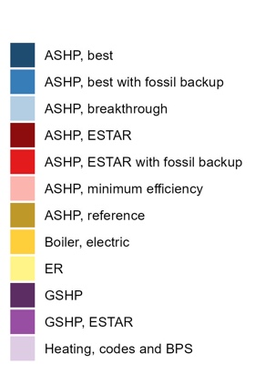
The impact of high heat pump adoption depends on the baseline heating stock
Residential heating electricity
CA: 20%*
FL: 66%
MA: 17%
WA: 55%
*Shares of total housing units w/ electricity as the main heating fuel (RECS)

Slide 27
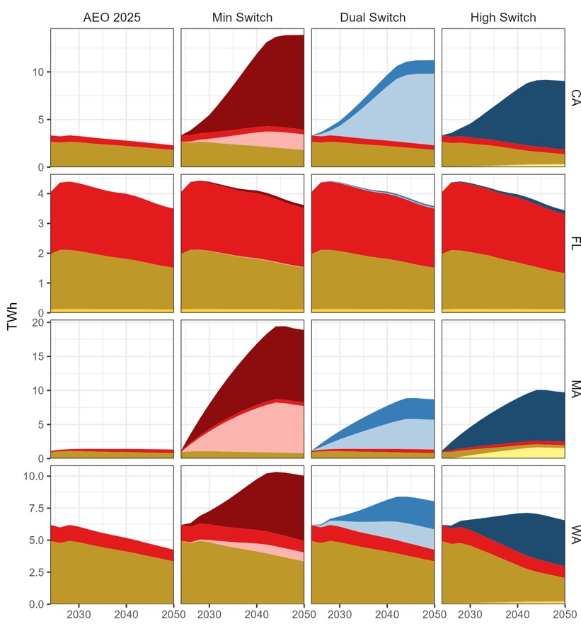
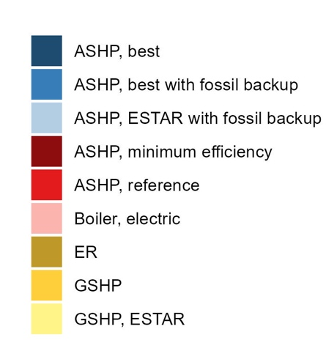
The impact of high heat pump adoption depends on the baseline heating stock
Residential heating electricity
CA: 20%*
FL: 66%
MA: 17%
WA: 55%
*Shares of total housing units w/ electricity as the main heating fuel (RECS)

Slide 28
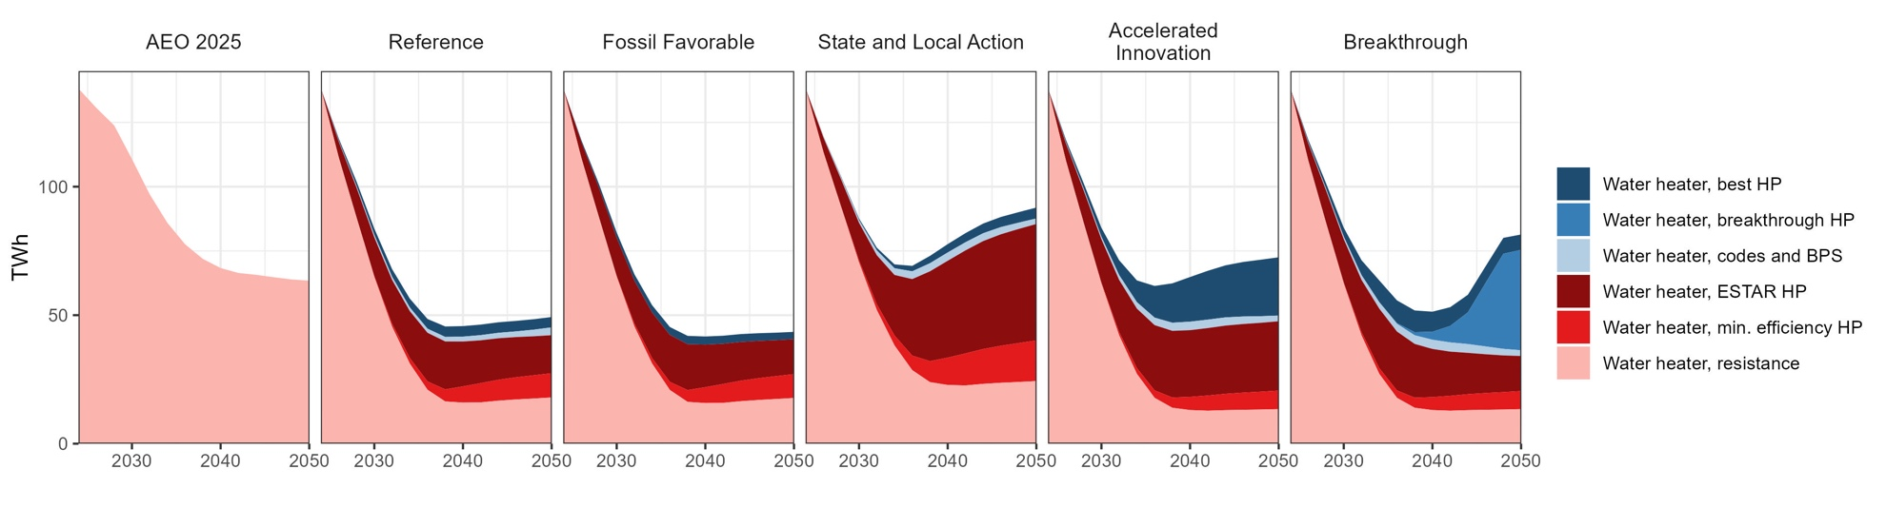
Efficiency from heat pump water heaters reduces electricity for water heating even with substantial fuel switching
Residential water heating electricity
Notes:
The “typical” resistance WH in the AEO forecast switches to a HPWH (EF 2.3) in 2029 to reflect the enacted appliance standard.

Slide 29
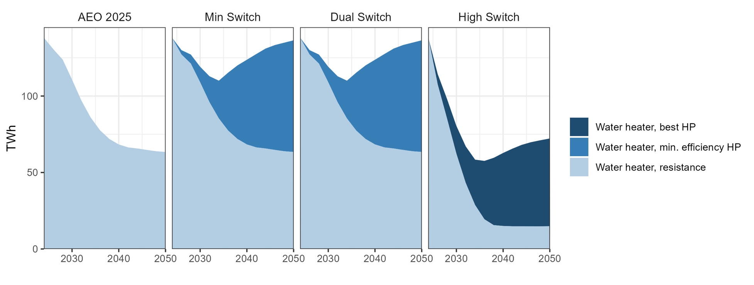
High fuel switching to minimum efficiency water heaters leads to near-term reductions but longer-term load growth
Residential water heating electricity

Slide 30
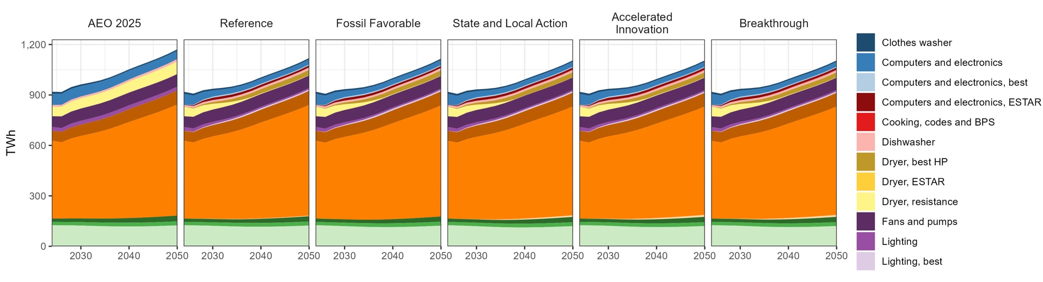
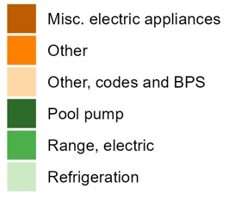
Non-thermal residential end uses: aggressive efficiency reduces appliance electricity use, but ‘other’ consumption remains unaffected
Residential electricity for non-thermal end uses
Notes:
”Other” includes vacation homes, medical equipment, model error, etc.

Slide 31
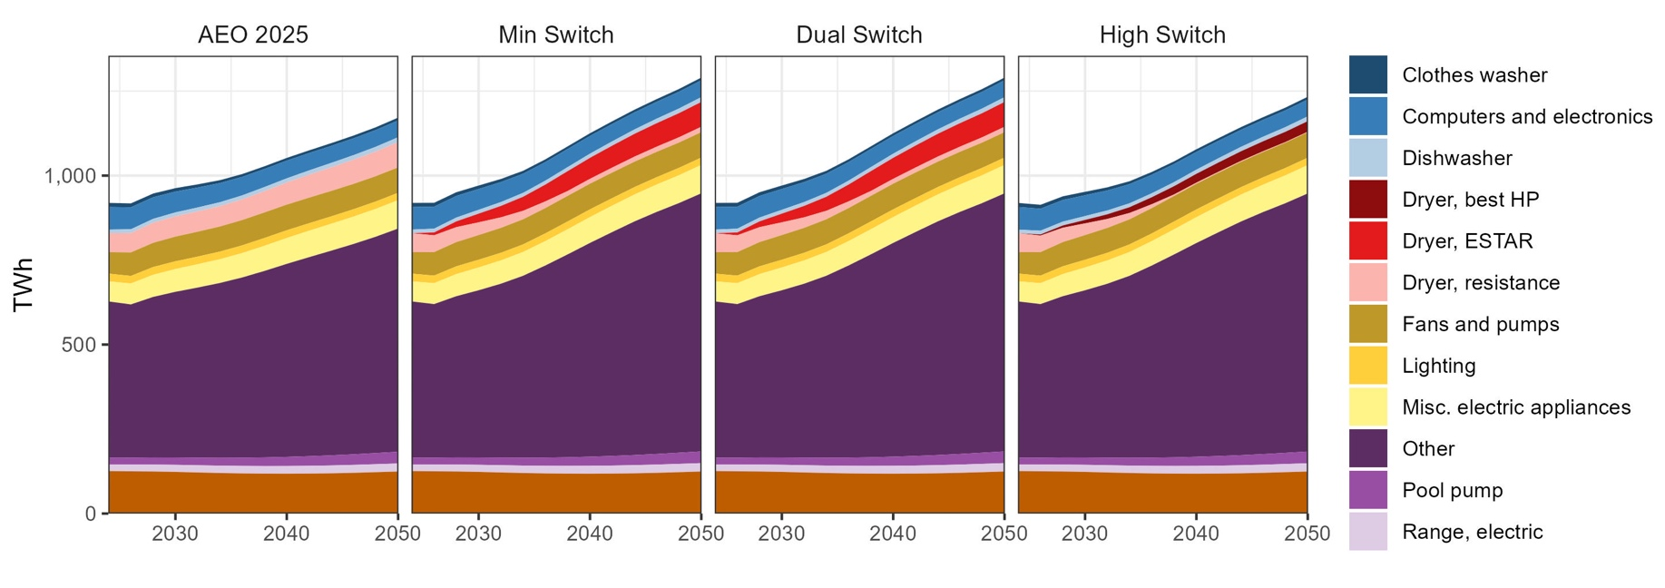

Non-thermal residential end uses: aggressive efficiency reduces appliance electricity use, but ‘other’ consumption remains unaffected
Residential electricity for non-thermal end uses
Notes:
”Other” includes vacation homes, medical equipment, model error, etc.

Slide 32
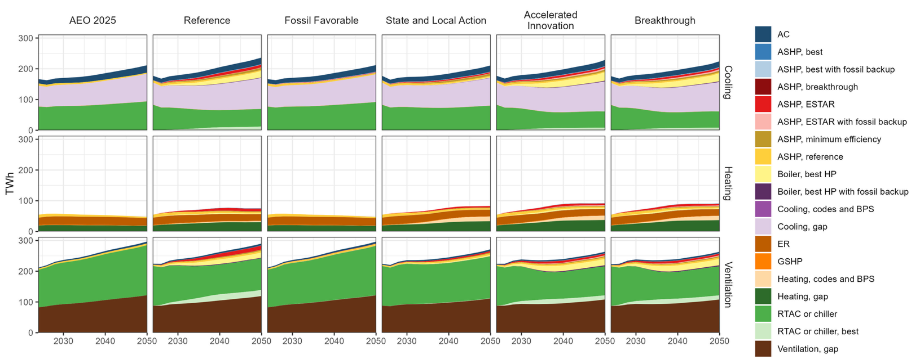
Increases in commercial electric heating are driven primarily by BPS, but are outweighed by larger cooling and ventilation demand
Commercial HVAC electricity
Notes:
Technology groupings include installations with and without envelope upgrades.
Ventilation is classified based on cooling technology.

Slide 33
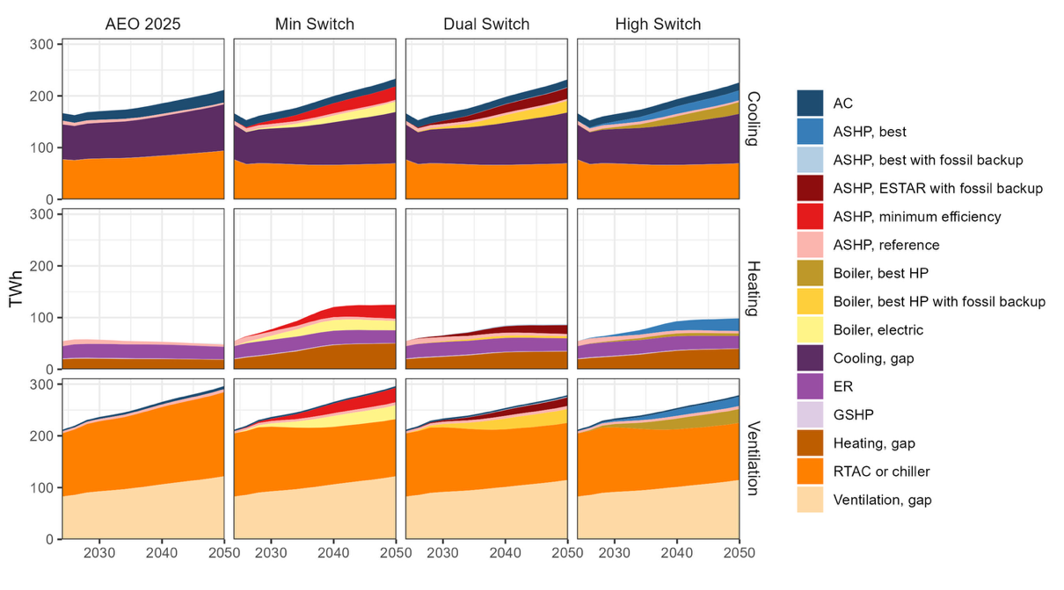
Increases in commercial electric heating are driven primarily by BPS, but are outweighed by larger cooling and ventilation demand
Commercial HVAC electricity
Notes:
Technology groupings include installations with and without envelope upgrades.
Ventilation is classified based on cooling technology.

Slide 34
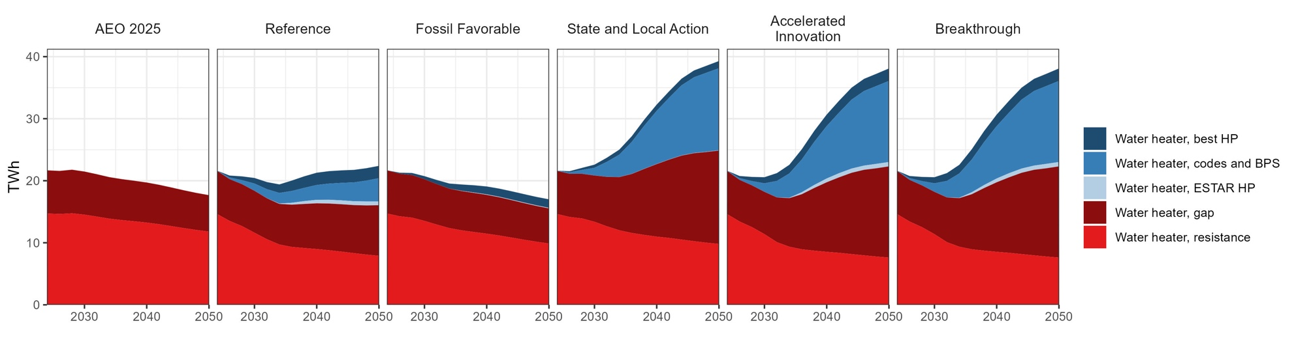
Increases in commercial electric water heating are driven primarily by BPS
Commercial water heating electricity

Slide 35
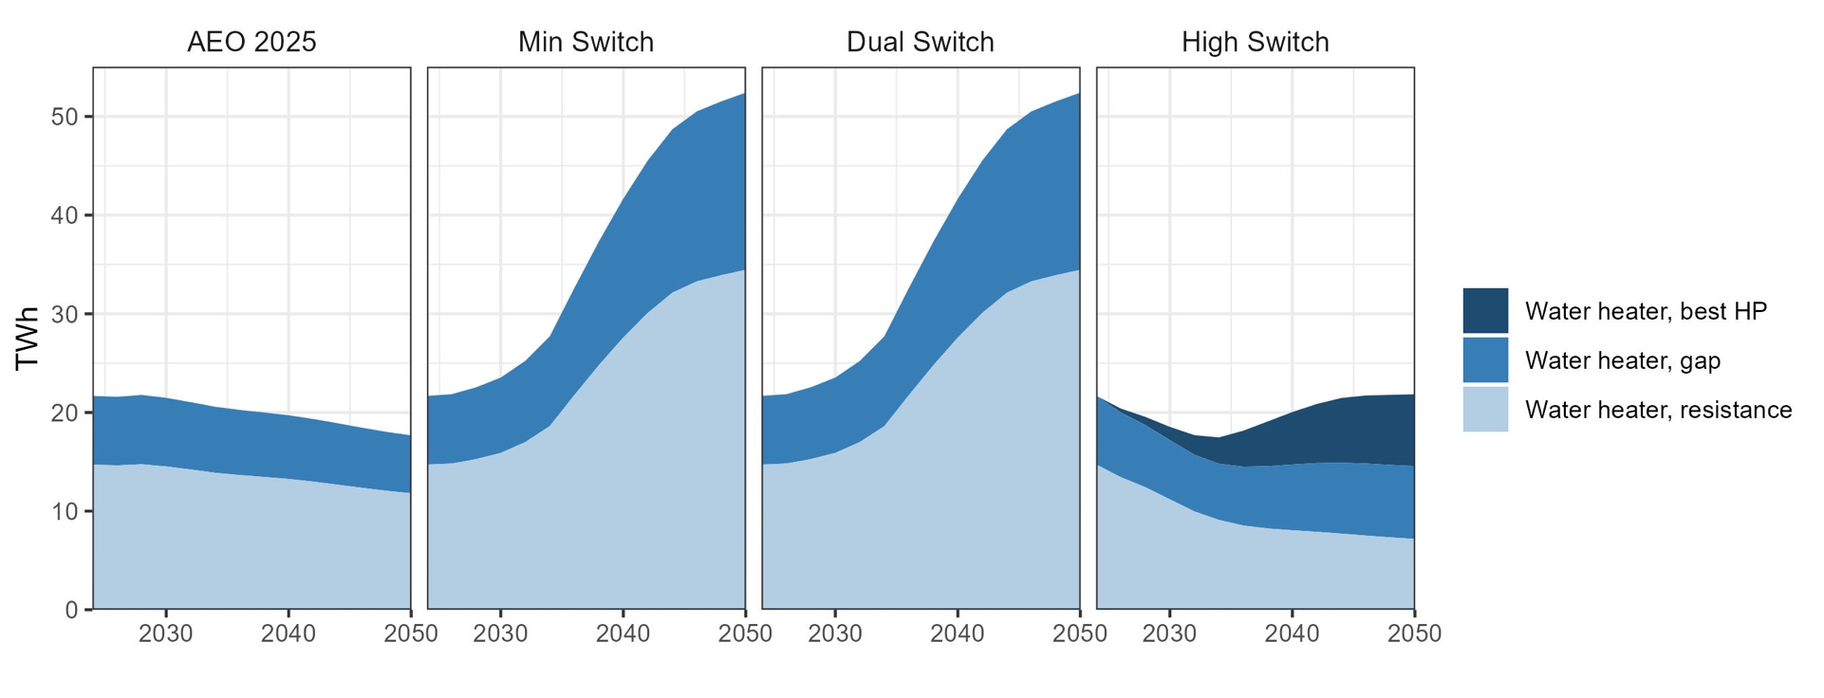
High fuel switching to only the most efficient commercial HPWHs blunts potential demand growth
Commercial water heating electricity

Slide 36
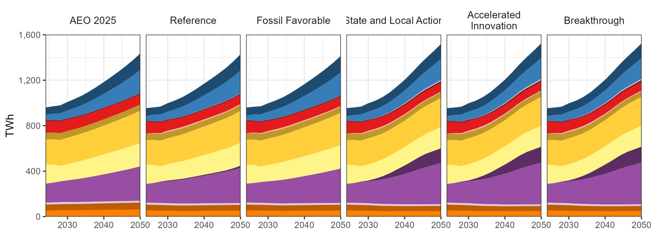
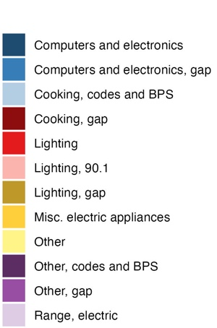
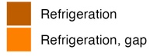
Non-thermal commercial end uses: minimal impacts beyond increased electricity from BPS
Commercial electricity for non-thermal end uses
Notes:
”Other” includes miscellaneous electric loads, ‘non-building’ loads (e.g., water pumps), model error, etc.

Slide 37
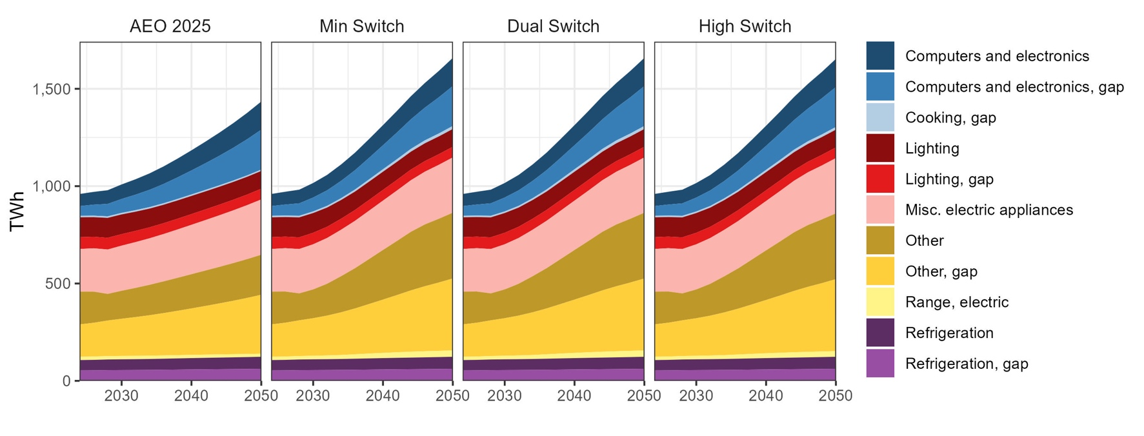
Non-thermal commercial end uses: negligible difference in efficiency assumptions or annual demand growth across the sensitivity cases
Commercial electricity for non-thermal end uses
Notes:
”Other” includes miscellaneous electric loads, ‘non-building’ loads (e.g., water pumps), model error, etc.

Slide 38
Results County and hourly resolution

Slide 39
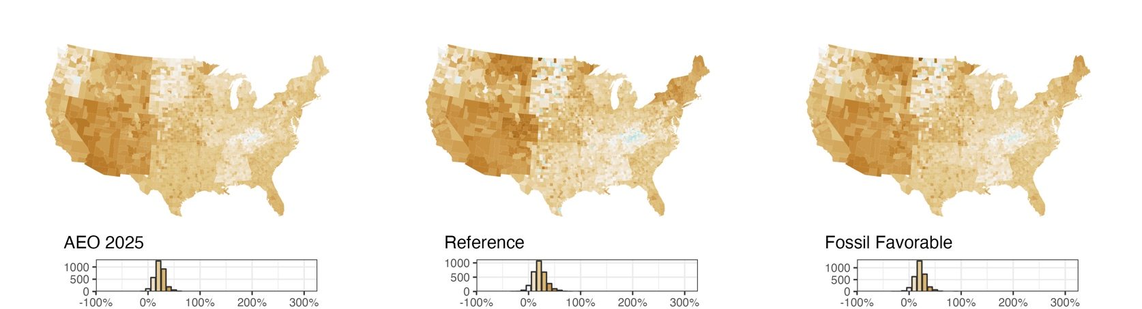
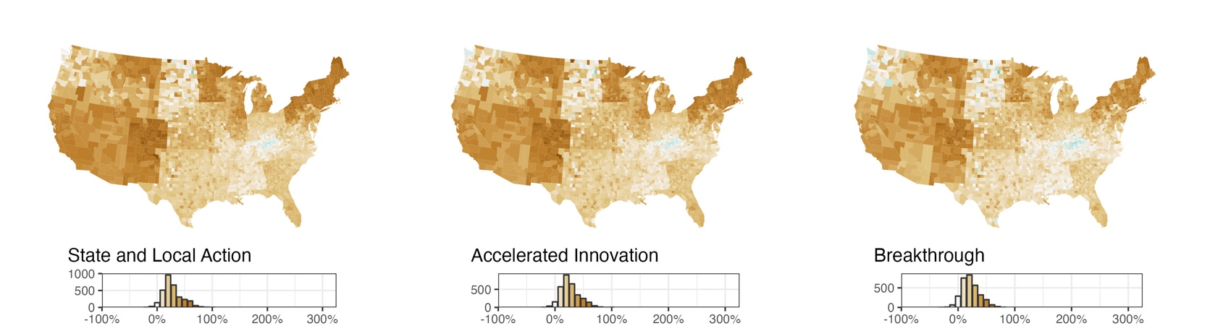
Almost all counties see growth in building electricity by 2050
Change in building annual electricity, 2026-2050

Slide 40
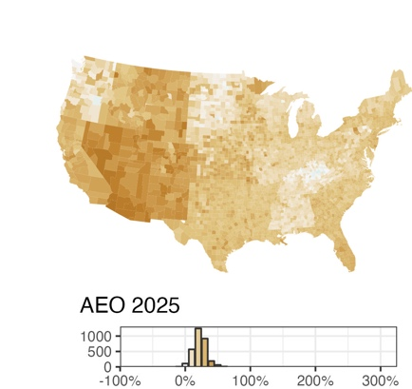
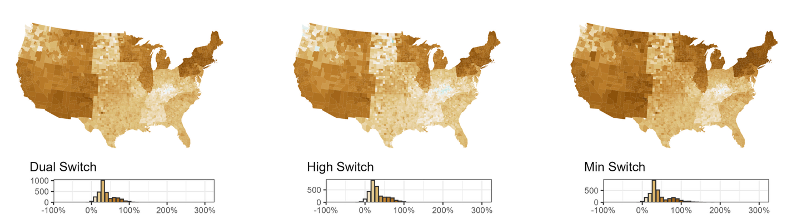
Almost all counties see growth in building electricity by 2050
Change in building electricity, 2026-2050
Change in building annual electricity, 2026-2050

Slide 41
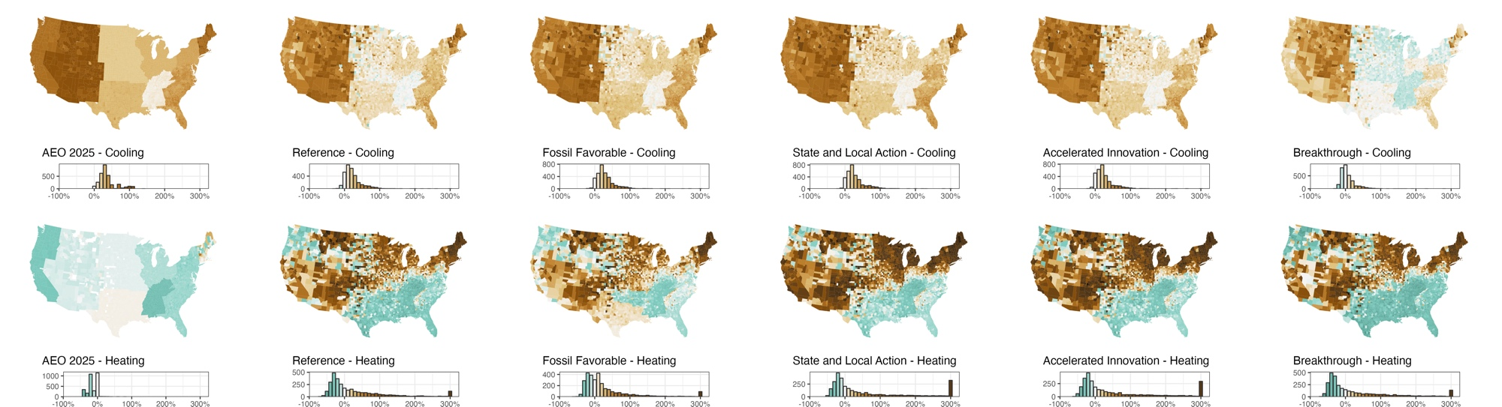
Efficiency and decreased HDD can reduce residential electric heating by 2050 in some regions even with substantial fuel switching
Change in residential annual heating and cooling electricity, 2026-2050

Slide 42
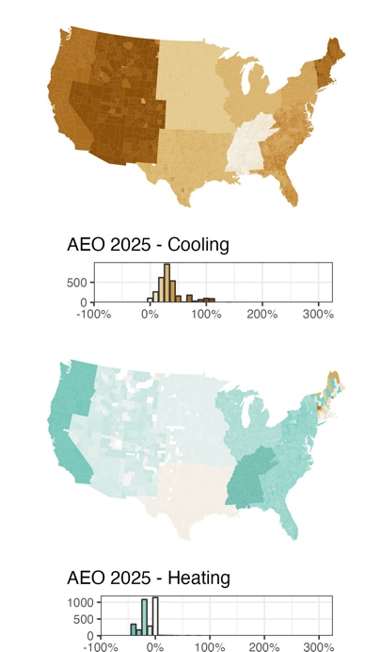
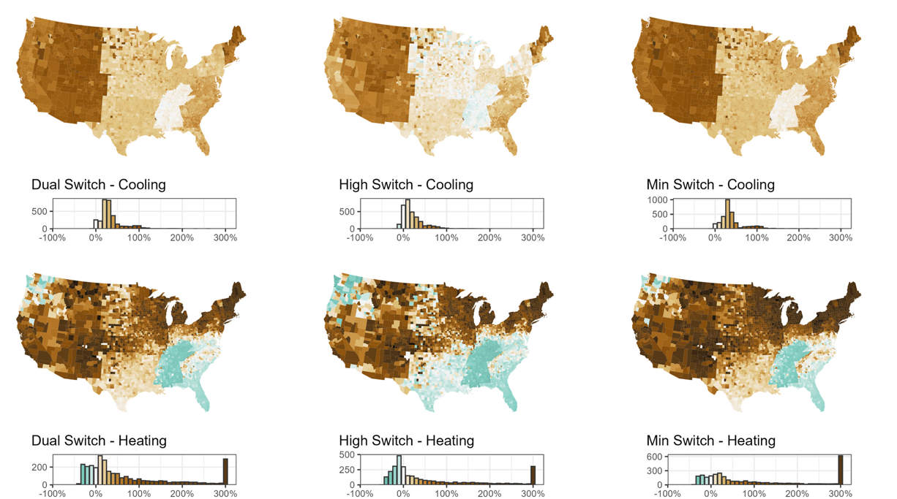
High fuel switching to min. efficiency or dual fuel HPs without resistance switching drives more heating growth in Southeast/Northwest
Change in residential annual heating and cooling electricity, 2026-2050

Slide 43
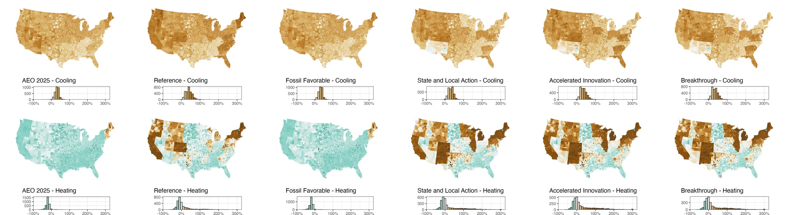
State and local action drive cooling efficiency and heating fuel switching in commercial buildings, primarily through BPS
Change in commercial annual heating and cooling electricity, 2026-2050

Slide 44
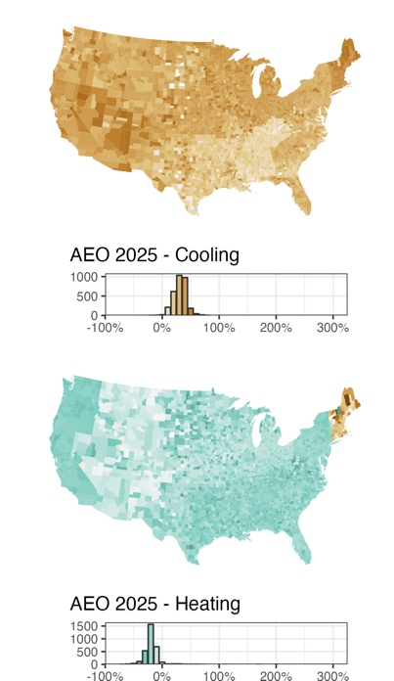
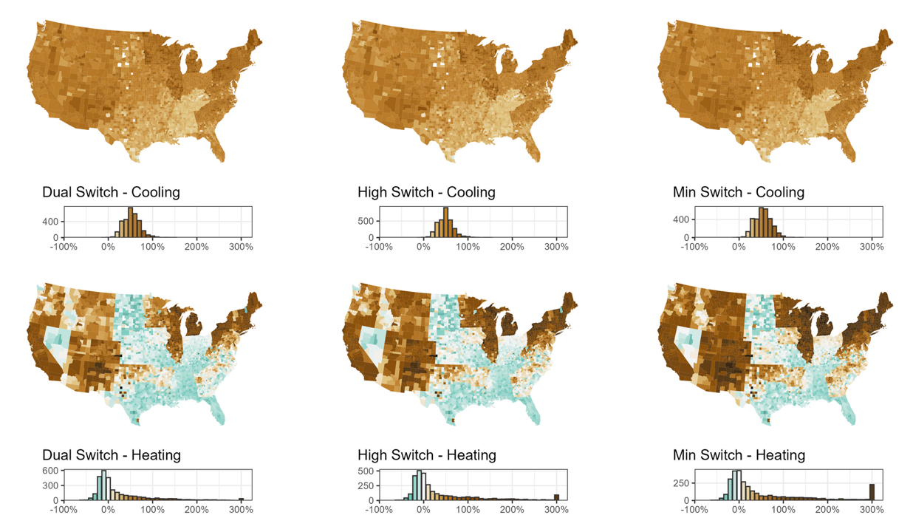
More counties with ~4X growth in commercial heating given code/BPS-driven fuel switching without backup fuel and/or parallel efficiency
Change in commercial annual heating and cooling electricity, 2026-2050

Slide 45
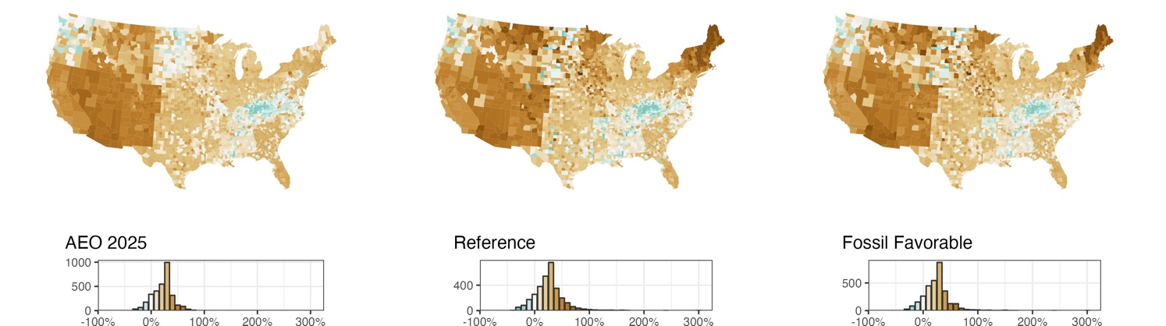
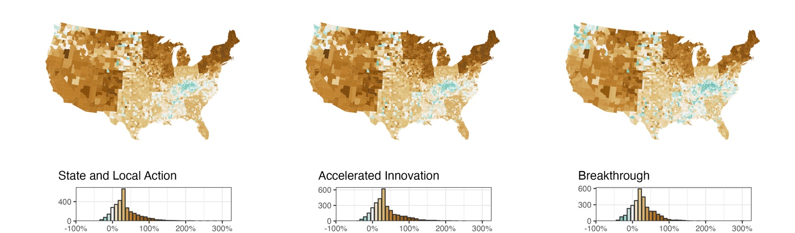
Buildings peak changes more than total electricity, both increases and decreases
Change in buildings peak hour electricity, 2026-2050

Slide 46
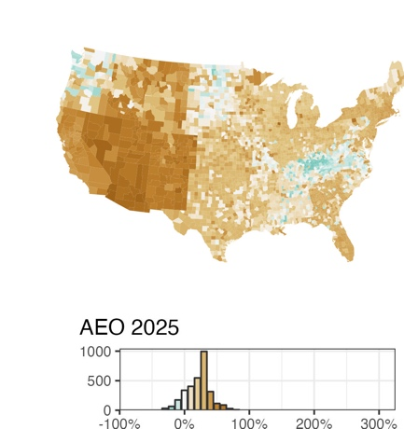
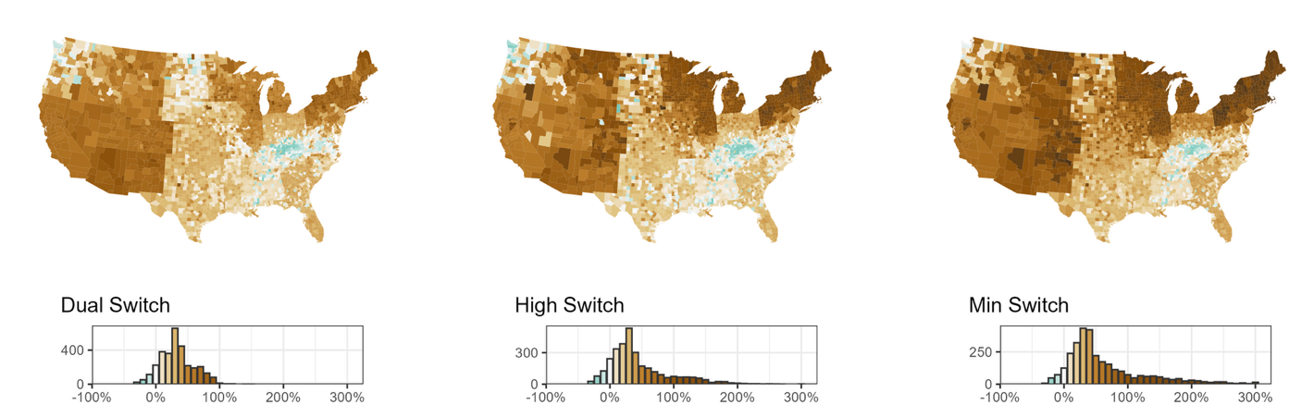
Potential benefits of high switching to dual fuel vs. min. efficiency electric are more evident under the peak metric
Change in buildings peak, 2026-2050
Change in buildings peak hour electricity, 2026-2050

Slide 47
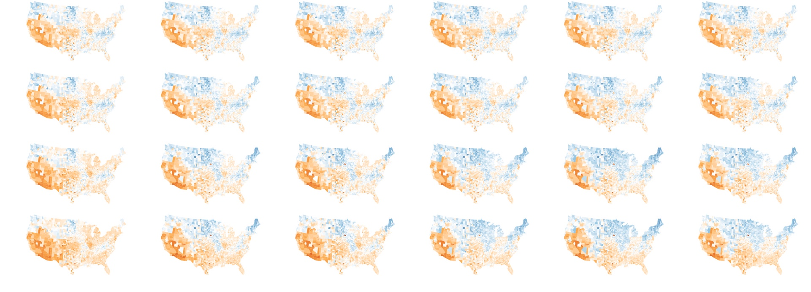
Winter to summer peak ratio: Strong shifts from fuel switching in Northeast, Midwest
AEO 2025
Reference
Fossil Favorable
State and Local Action
Accelerated Innovation
Breakthrough
2026 2030 2040 2050

Slide 48
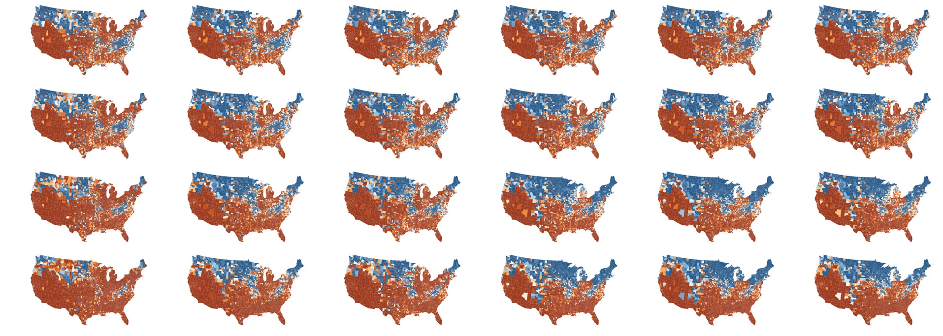
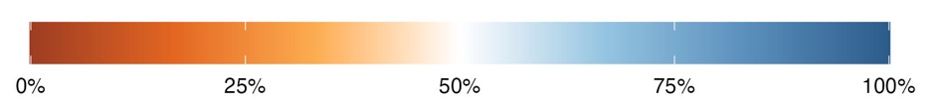
Winter % top 100 load hours: Strong shifts from fuel switching in Northeast, Midwest
AEO 2025
Reference
Fossil Favorable
State and Local Action
Accelerated Innovation
Breakthrough
2026 2030 2040 2050

Slide 49
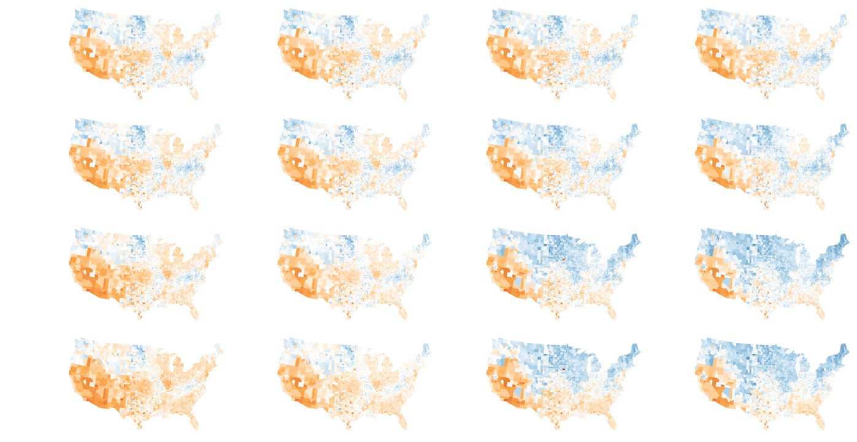
Winter to summer peak ratio: Dual-fuel avoids much of the shift towards winter-peaking
AEO 2025
Dual Switch
High Switch
Min. Switch
2026
2030
2040
2050

Slide 50
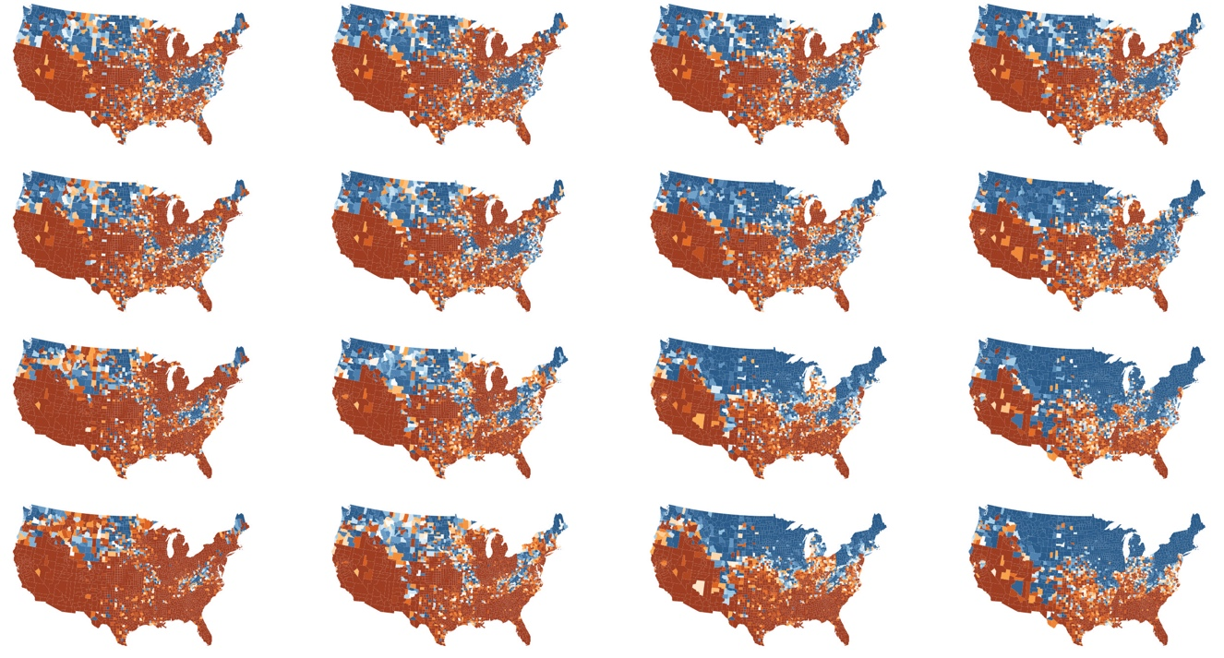
Winter % top 100 load hours: Dual-fuel avoids much of the shift towards winter-peaking
AEO 2025
Dual Switch
High Switch
Min. Switch
2026
2030
2040
2050

Slide 51

Scenarios with more fuel switching see a wider spread in seasonal peak ratios by 2050, which also grow larger
In 2026, most counties have similar summer and winter buildings peaks.
In 2050 in the AEO case, more counties have a summer buildings peak, and the peak is relatively higher.
In the Breakthrough case, the ratios of the peaks tend to grow larger over time.
Winter to summer peak ratio, distribution across counties

Slide 52
Results Annual energy costs

Slide 53

Annual energy costs generally grow – driven by electricity cost increases – but scenarios with greater efficiency see slower growth
Note: Fossil fuel/electricity prices are lower/higher than the AEO Reference Case in “Fossil-Favorable” and higher/lower in ”State Action,” ”Accelerated,” and “Breakthrough” cases. All other cases use AEO Reference Case fuel prices.

Slide 54

Growth in electricity costs accelerates with fuel switching to less efficient equipment and is persistent across commercial scenarios
Note: Fossil fuel/electricity prices are lower/higher than the AEO Reference Case in “Fossil-Favorable” and higher/lower in ”State Action,” ”Accelerated,” and “Breakthrough” cases. All other cases use AEO Reference Case fuel prices.

Slide 55
Discussion

Slide 56
Takeaways from the v1.0.0 dataset
Significant overall and non-electric annual energy reduction potential with endogenous technology adoption that includes representation of state and local adoption drivers.
More overall reduction in residential, but comparable levels of non-electric reduction across building types.
State and local incentives, state-level appliance emissions regulations, and new building codes that restrict/disincentivize fuel use are the main drivers of fuel switching and energy efficiency improvements in residential buildings.
BPS and codes are the main drivers of change in commercial electricity consumption.
With high levels of efficiency and fuel switching, counties with winter-peaking building demand expand from the Northwest/Southeast to the Northeast, Midwest, and Appalachia.
While annual energy costs grow across scenarios, high efficiency penetration delivers deep cost savings (relative to AEO) that significantly slows or even reverses growth in energy costs over time; cost savings vary by state given differences in rates/policies.

Slide 57
Key limitations in the v1.0.0 dataset
Coarse base-year calibration to historical state-level, monthly electricity use data.
Important assumptions from AEO (e.g. changes in HDD/CDD, building construction and demolition) are made at the census division level and do not vary by state or county.
While some enacted policies that could drive technology adoption (in particular, fuel switching) are represented at the city-level, possible future policies are generally represented as having a broader, state-level application.
A single weather year for hourly load shapes (2018) is applied through all years of projected annual energy consumption.
The commercial gap shape, which applies to approximately 40% of commercial electricity, is the same for every end use and projection year.
The analysis only covers the contiguous US.

Slide 58
Where the BSS dataset could go from here
Regionally-focused refinement and application of the BSS data, including:
Further calibration of BSS baselines with more resolute/comprehensive data sets within example grid regions, including metered end-use data. Such data can help us understand why so much calibration is needed.
Pilot collaborations with utility planners, analysts and/or public advocates, state/local program managers, and others to leverage BSS load data and scenario modeling framework to inform grid planning exercises.
Deeper investigation of avoided power system costs – particularly distribution
County/hourly load shapes from BSS could replace existing demand-side load shape projections used in the Electricity Standard Scenarios; BSS DF potential shapes could also be dispatched as part of this power sector modeling work.
Incorporate alternate forecasts of data center load growth (included in commercial ‘other’ building loads currently), extend investigation of geothermal technologies.
Regular updates to: measure cost and performance (w/ automated BTB integration); underlying AEO forecast; Res/ComStock load shapes; scenarios/adoption drivers.

Slide 59
Thank you

Slide 60
Baseline calibration

Slide 61



Baseline calibration: Peak month in BSS is often winter when it is summer in EIA 861M
GA, residential
CO, residential
BSS uses 2018 weather
Even in the Southeast where 2018 was unusually cold, TMY weather is much closer to uncalibrated BSS (2018) than EIA 861M

Slide 62



Baseline calibration: Summary of monthly calibration factors
Residential
They’re all in a reasonable range
Mean and median are very close to 1.
Commercial
Some are high. ND is the worst, many others are in SD, WY, MT (empty, cold states)
Mean and median are very close to 1

Slide 63
Commercial gap model

Slide 64
Share of energy NOT modeled by ComStock (CBECS 2018)
Building type | Electricity | Natural gas
Assembly | 100% | 100%
Education | 25% | 25%
Food Sales | 100% | 100%
Food Services | 8% | 5%
Health Care | 0% | 0%
Lodging | 45% | 44%
Office | 0% | 0%
Mercantile and Service | 28% | 32%
Warehouse | 67% | 62%
Other | 100% | 100%

Slide 65


The gap model tends to flatten the overall daily load shape in all seasons
Gap load shape is opposite from the commercial/residential load shapes, which flattens the overall daily shape.
Other BAs show the same pattern.

Slide 66

Gap model: average hourly multipliers by month
In all states, the highest multipliers are at night.
In general, the variation within the average day is greater than between months.
In many states, the gap is slightly bigger in the summer.

Slide 67
Sub-federal adoption drivers

Slide 68

Adoption drivers and methods
Scout is built on top of the EIA Annual Energy Outlook (AEO), so inputs reflect additional regulations/standards/incentives/codes/rates that are not already baked into the model.
Sub-federal drivers fall within the following categories:
Appliance emissions regulations
Building performance standards (BPS)
Incentives
Codes
Rates
Inputs are specific to state, building type(s), building vintage(s), fuel type(s), end use(s), technology type(s), and years.
Parameters vary by input category.
Drivers that only affect a portion of a state’s residential or commercial building stock were reflected through an “applicable fraction”.
Calculated using ResStock and ComStock energy consumption.
Defined more aggressive case with stronger drivers for electrification adoption.

Slide 69

Codes
Codes data include inputs on onsite fuel reduction and energy index improvements from adopting the latest code version or a stretch code.
AEO does not include anything on codes that may require/encourage onsite fuel reductions, may sometimes assume less energy index improvement than occurred with recent code adoption.
In the reference case, we represent code changes that aren’t captured in the AEO/NEMS baseline.
Example: MA Stretch Energy Code.
The more aggressive projections assume that all states currently considering more aggressive code adoption do so statewide by 2030, and all U.S. Climate Alliance states (USCA) do so by 2035. The CA Title 24 Energy Code serves as a model.
Source: Energy.gov Stretch Codes

Slide 70

Building Performance Standards (BPS)
BPS are not represented in the National Energy Modeling System (NEMS) - characterized both current examples and expectations of which states might adopt them in the future under different scenarios.
BPS data include inputs for onsite fuel use reduction and EUI reduction vs. benchmark year.
States covered in reference case include CA, CO, DC, MA, MD, MO, NV, NY, WA.
Example: NYC Citywide BPS for com. and large multifamily buildings.
The more aggressive projections assume that all states currently considering BPS enact them statewide by 2030 (w/ 2035 targets), and all U.S. Climate Alliance states (USCA) do so by 2035 (w/ 2040 targets). The CO BPS serves as a model.
Source: Energy.gov Building Performance Standards

Slide 71

Upfront cost incentives
Incentives cover policies that reduce the upfront cost of equipment (tax credits and rebates, but not financing).
Reference case incentives phase out federal incentives beginning in 2026; state-run IRA-funded programs already existence are assumed to continue through 2032 (AEO does not account for IRA-backed expansions of state rebate programs).
The more aggressive projections:
Reintroduce federal incentives from 2030-2050.
Extend state incentives to 2050.
Increase incentive levels to the high end of what’s currently available in 2030 (states with existing incentives) or 2035 (other USCA states).
Source: Efficiency Maine Residential Heat Pump Incentives

Slide 72
Appliance emissions regulations
Appliance regulation data cover two types of emissions-based restrictions:
Emissions-based equipment stds., like the one CARB is considering for heaters/WH
Clean heat standard, e.g. the CO Clean Heat Standard requires gas distribution utilities to cut emissions by 4% by 2025 and by 22% by 2030. Fuel switching to electric equipment is a key pathway being pursued by utilities.
Only the CO standard is “on the books” and assumed in the reference case.
The more aggressive projections assume that all states currently considering such policies enact them by 2030, and all U.S. Climate Alliance states (USCA) do so by 2035. The CARB policy serves as a model.

Slide 73
Rates
Represents rates that aim to make operating electric equipment look more economically favorable.
Reference rates represented in inputs include those in California, Minnesota, Massachusetts.
Example: Reduction in winter delivery charge for Unitil customers using heat pump space heating
Future scenario cases expand reference cases to additional utilities & states, expanding the Unitil model to include all of MA service, adding states also considering appliance emissions regulations by 2030, and adding all remaining US Climate Alliance states by 2035.

Slide 74
Demand flexibility modeling

Slide 75

Overview of modeling demand flexibility potential

Slide 76
Demand flexibility modeling Measure development

Slide 77



DF Modeling – Measure Peak Period Assumptions
Net Peak Period
Peak periods are identified for each state from the projected grid net load (total load net of variable renewable energy) in 2050 from Cambium, Mid-case scenario
For load shedding measures: 4 hours with highest average load including the peak hour during each season
For load shifting measures: 4 hours centered at the peak hour for each season
Seasons:
Winter: December 1 - March 31
Summer: June 1 - September 30
Intermediate: April 1 - May 31, October 1 - November 30
Example peak (shedding) period for load shedding and load shifting measures for different seasons

Slide 78


DF Modeling – DF Metrics
D3 – Demand Decrease Percentage*
Calculate the metric by postprocessing BuildStock simulation results:
Aggregate time series end use results for applicable buildings by state
Calculate D3 metric for each day during the targeted season(s)
Find the 75 percentile of the D3 distribution to feed in DR-Path for analysis
Measure | Seasons to aggregate
Precooling by thermostat control | Summer and Intermediate
Preheating by thermostat control | Winter
Thermostat setpoint setback during peak hours | Summer and Intermediate for cooling; Winter for heating
Dim lighting during peak hours | All seasons
Low priority device switching during peak hours | All seasons
* Reference: Developing and Evaluating Metrics for Demand Flexibility in Buildings: Comparing Simulations and Field Data, 10.20357/B7WW34

Slide 79
Residential DF measures
Measure | End Use Category | Load Change | Applicability
Precooling/Preheating for 4 hours with a 2 F offset | Cooling, Heating | Shifting | Applied to all dwellings with either heating or cooling system; approximately 99.7% of building stock
Precooling/Preheating for 4 hours with a 4F offset | Cooling, Heating | Shifting | Applied to all dwellings with either heating or cooling system; approximately 99.7% of building stock
Thermostat setpoint setback by 2F | Cooling, Heating | Shedding | Applied to all dwellings with either heating or cooling system; approximately 99.7% of building stock
Thermostat setpoint setback by 4F | Cooling, Heating | Shedding | Applied to all dwellings with either heating or cooling system; approximately 99.7% of building stock

Slide 80

Residential DF – 30k sample results

Slide 81

Residential DF – 30k sample results

Slide 82

Residential DF – 30k sample results

Slide 83

Residential DF – 30k sample results

Slide 84

Commercial DF Modeling - Workflow
Measure Development Workflow
* https://github.com/LBNL-ETA/Openstudio-GEB-gem

Slide 85
Commercial DF Modeling - Measures
Measure | End Use Category | Load Change | Applicability
Precooling by thermostat control | Cooling | Shifting | ✓ Buildings with electric cooling ✘ Exclude buildings with strict temperature requirement
Preheating by thermostat control | Heating | Shifting | ✓ Buildings with electric heating ✘ Exclude buildings with strict temperature requirement
Thermostat setpoint setback during peak hours | Heating and Cooling | Shedding | ✓ Buildings with electric cooling or heating ✘ Exclude buildings with strict temperature requirement
Dim lighting during peak hours | Lighting | Shedding | ✘ Exclude buildings with strict illuminance level requirement
Low priority device switching during peak hours | Plug Load | Shedding | ✓ Office-like space types

Slide 86
Commercial DF Modeling – Measure Parameters
Adjustment
Precooling:
Lower the cooling setpoint by 4°F for 4 hours before the defined peak period
Change the setpoint back during the peak period
Cooling setpoint won’t be lower than the heating setpoint at the same time to avoid deadband issue
Preheating:
Raise the heating setpoint by 4°F for 4 hours before the defined peak period
Change the setpoint back during the peak period
Heating setpoint won’t be higher than the cooling setpoint at the same time to avoid deadband issue
Thermostat setpoint setback:
Raise cooling setpoint by 5°F and lower the heating setpoint by 2°F during the defined peak period
Dim lighting:
Reduce the lighting load by 30% for occupied spaces and 60% for unoccupied spaces during the defined peak hours
Low priority device switching:
Reduce electric equipment loads by 20% during the defined peak hours

Slide 87
Commercial DF Modeling – Postprocessing
Each model can be used multiple times within each state, or for more than one state
9941 unique models simulated to represent 17990 buildings.
Each building has an assigned weight.
Each building’s load profile is multiplied by the weight when aggregated for each state to calculate the metrics.
For heating and cooling end use, the electricity consumption by pumps and fans are not included.
The D3 metrics are calculated based on the applicable buildings. For the use of the following processing in DR-Path, the applicable buildings are buildings with the corresponding end use type.
For example, for the Lighting measure, it means buildings with electric lighting (basically all buildings), while for preheating measure, only buildings with electric heating are counted.
For the thermostat setback measure, the D3 for cooling and heating are calculated separately.

Slide 88

Commercial DF Modeling – Postprocessing
ComStock sampling method: Models in one state can be used as models for other states
when aggregating load for buildings in state A with peak period S1, some buildings are simulated with models from state B with peak period S2
Reduced D3 results (even negative D3 for load shifting measures if the load taking period overlaps with the load shedding period)

Slide 89

Commercial DF Modeling – 10k Sample Results

Slide 90

Commercial DF Modeling – 10k Sample Results

Slide 91


Commercial DF Modeling – 10k Sample Results

Slide 92

Commercial DF Modeling – 10k Sample Results

Slide 93

Commercial DF Modeling – 10k Sample Results

